Slide 1
Exploring venues in Mumbai, India using Foursquare and Zomato API
Rahil Merchant

Slide 2
Index
Introduction
Data
Methodology
Exploratory Data Analysis
Results and Discussion
Conclusion

Slide 3
Introduction - Background
Whenever a person searches for a venue in a new city, they’re highly interested in the best places that the city has to offer.
The person might want to know how good a given restaurant is or the price range it falls under. This would help decide which venue to choose amongst the many venues in the city.
Combining the location of the venues in the city with their price and rating information would surely help visitors in a city make better informed decisions about the places they should visit.
This project explores various venues in Mumbai and attributes the data based on user ratings and average price.
To explore this information, this project involves the juxtaposition of both the Foursquare API and the Zomato API to fetch complete information of various venues.
Further, a map of the venues with specific color attributes will be plotted to highlight their position, and information about these venues.
This enables any visitor to take a quick glance and decide what place to visit.

Slide 4
Introduction – Targeted Audience
The target audience for such a project is twofold.
Firstly, any person who is visiting Mumbai, India can use the plots and maps from this project to quickly select places that suit their budget and rating preferences.
Secondly, a company can use this information to create a website or a mobile application, which is updated on a regular basis, to allow individuals to the city or even expand same functionality to other places.

Slide 5
Introduction – Targeted Audience
The target audience for such a project is twofold.
Firstly, any person who is visiting Mumbai, India can use the plots and maps from this project to quickly select places that suit their budget and rating preferences.
Secondly, a company can use this information to create a website or a mobile application, which is updated on a regular basis, to allow individuals to the city or even expand same functionality to other places.

Slide 6
Data Sources
To get location and other information about various venues in Mumbai, I used two APIs and decided to combine the data from both of them together.
Using the Foursquare’s explore API, I fetched venue details up to a range of 44 kilometers from the center of Mumbai and collected their names, categories and locations (latitude and longitude).
Using the name, latitude and longitude values, I used the Zomato search API to fetch venues from its database.
Due to certain redundancies in the combined data, the data had to be cleaned and certain records had to be removed.

Slide 7
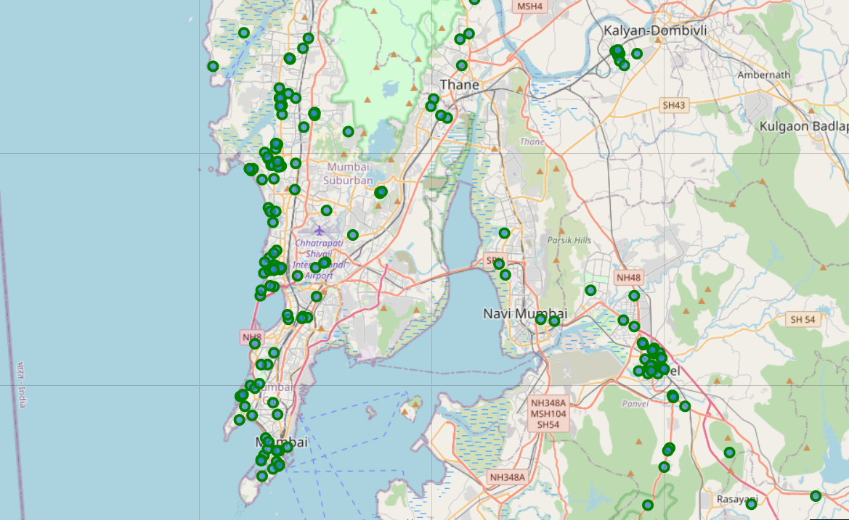
Venues retrieved from Foursquare API

Slide 8
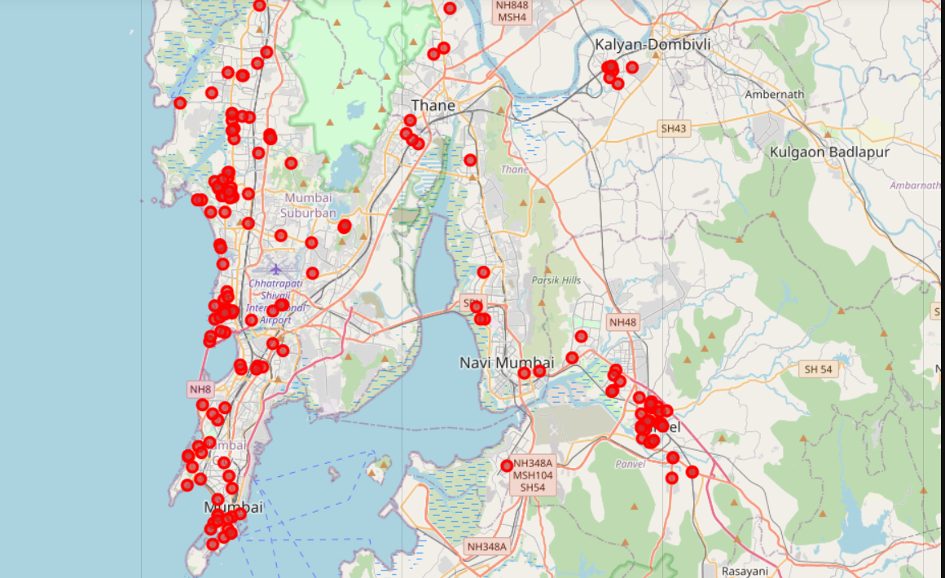
Venues retrieved from Zomato API

Slide 9
Data Cleaning
To combine the two datasets, I had to check that the latitude and longitude values of each corresponding venue match. After careful analysis, I decided to drop all corresponding venues from the two datasets that had their latitude and longitude values different by more than 0.0004 from one another. This removed many outliers from the two datasets. Once this was done, I observed that there were still some venues which were not correctly aligned.
They can be categorised as follows:
There are venues that have specific restaurants/cafes inside them as provided by Zomato API.
Two locations are so close that they have practically same latitude and longitude values.
Some venues have been replaced with new venues.
Venues belonging to category 1 and 3 are okay to keep. However, the venues that belong to category 2 should be dropped. After careful inspection and removal, the final dataset had a total of 41 venues with which we can work.

Slide 10
Methodology and exploratory data analysis
As a first step, I retrieve the venues in Mumbai from Foursquare and Zomato APIs. I extract the location data from the Foursquare API for all venues up to a distance of 44 kilometers from the center of Mumbai. Using this, I fetch the venue information including price and rating data from Zomato API.
Using data cleaning, the dataset from the two APIs will be combined based on the venue names, latitude, and longitude values. One to one matching and careful data inspection would be used to remove any remaining outliers
The final data will include the venue name, category, address, latitude, longitude, rating, price range, and average cost per person.

Slide 11
Methodology
Using this dataset, I begin by analyzing the top venue types that exist in Mumbai.
I will then explore the venues on maps. This will allow us to better understand the location of various venues and the places where many venues co-exist and create place worth visiting.
I’ll also explore the venues based on the ratings and price range of various venues.
The venues will be plotted using proper color coding such that a simple glance at the map would reveal the location of the venues as well as give information about them.
I aim to identify places which can be recommended to visitors based on their price and rating preferences. I’ll also cluster the venues and see if we can draw meaningful information out of what kind of venues exist in Mumbai.
As a final step, I will analyse these plots and try to draw conclusions on what places can be recommended to visitors.

Slide 12
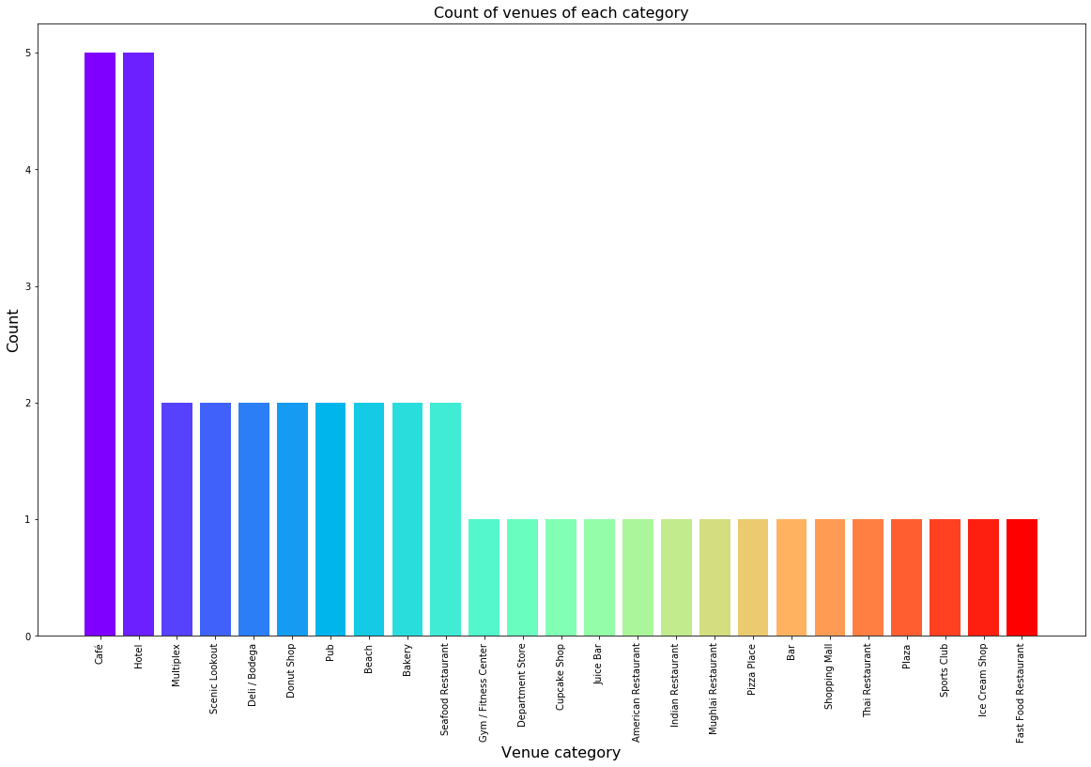
Exploratory Data analysis
Categories:
I begin my analysis by taking a look at the various categories of venues that exist in Mumbai. From the below figure, we see that the majority venues are actually Cafes and Hotels.

Slide 13
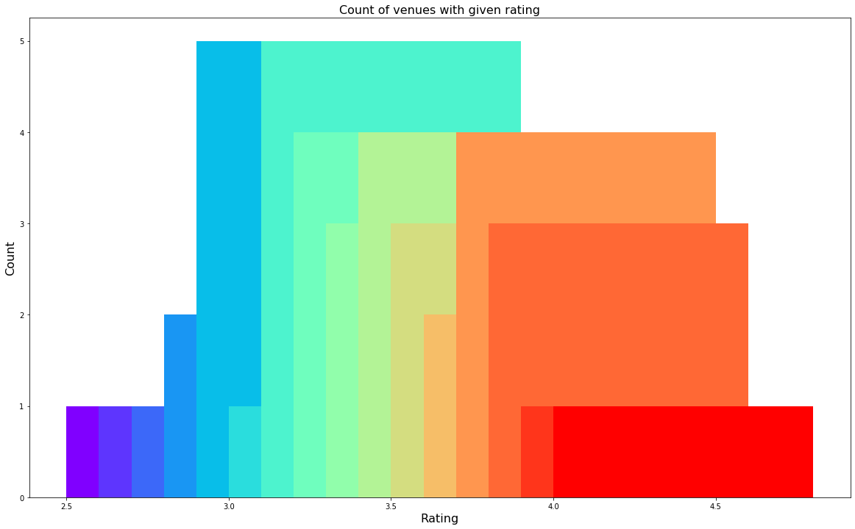
Exploratory Data analysis
Rating:
I’ll explore the ratings of various venues in Mumbai. I decided to plot a bar chart with x-axis as the rating from 1 to 5 and the y-axis as the count of venues with that rating. I decided to plot the bar chart to see what average rating venues get in Mumbai.

Slide 14
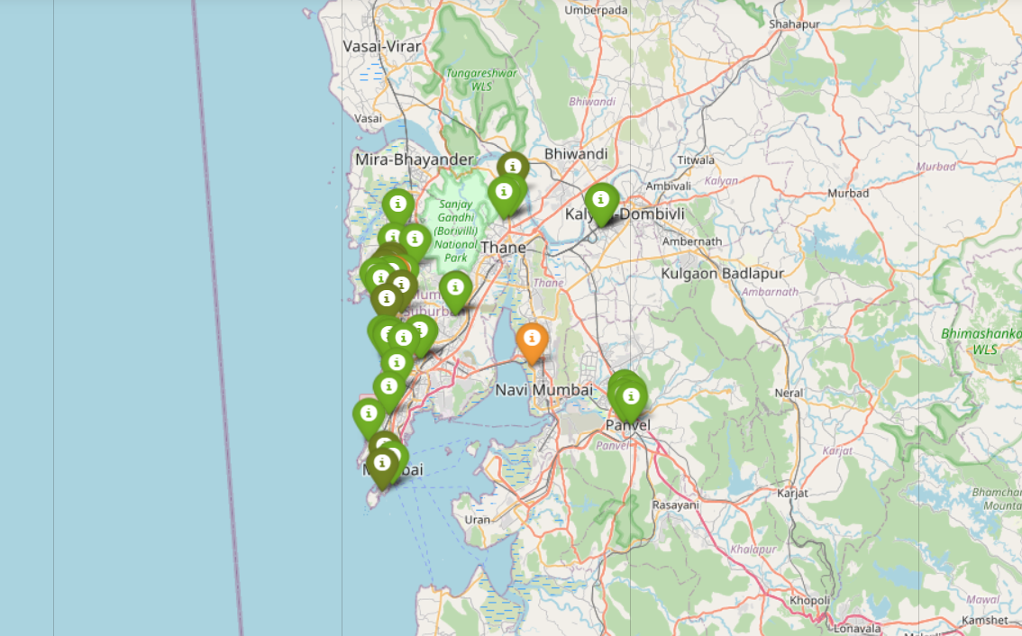
Exploratory Data analysis
Rating:
We plotted the venues on the map of Mumbai. The venues that were rated below 3 were marked by red and orange while the venues that were rated more than or equal to 3 were plot as green and dark green.
It appears that venues located near about Jogeshwari, Oshiwara and Colaba are rated the highest.
If someone wants to explore new venues, they should definitely check out Jogeshwari, Oshiwara and Colaba.

Slide 15
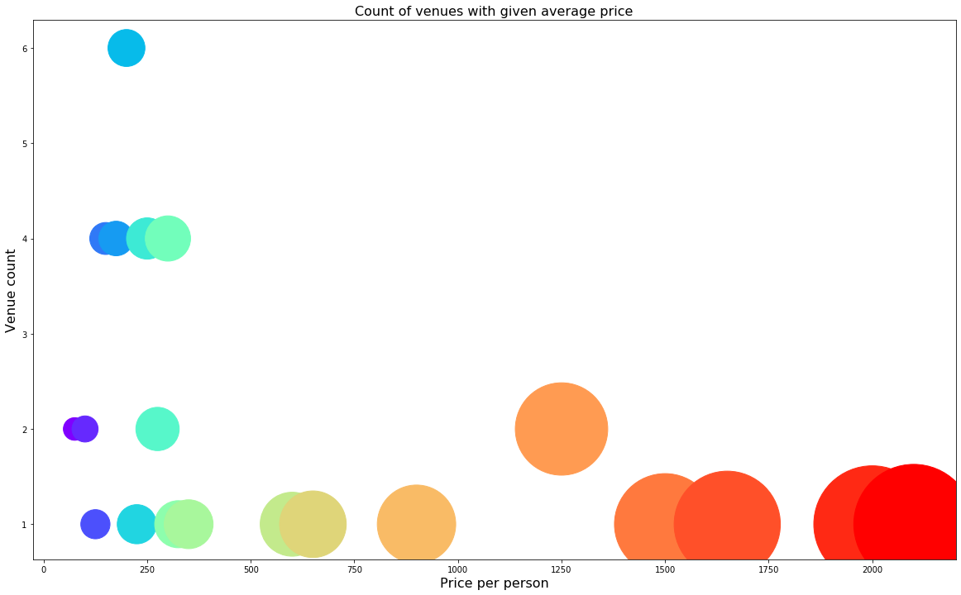
Exploratory Data analysis
Price:
Next, I explore the average prices of all venues for one person using a scatter plot along with the count of venues with that average price per person. The adjoining reveals that the majority venues have an average cost of Rs 150 to Rs 300 for one person. Even though the maximum venues lie in that range, the actual range of prices is very different. There are places with average price even as high as Rs 2000+ for one person.

Slide 16
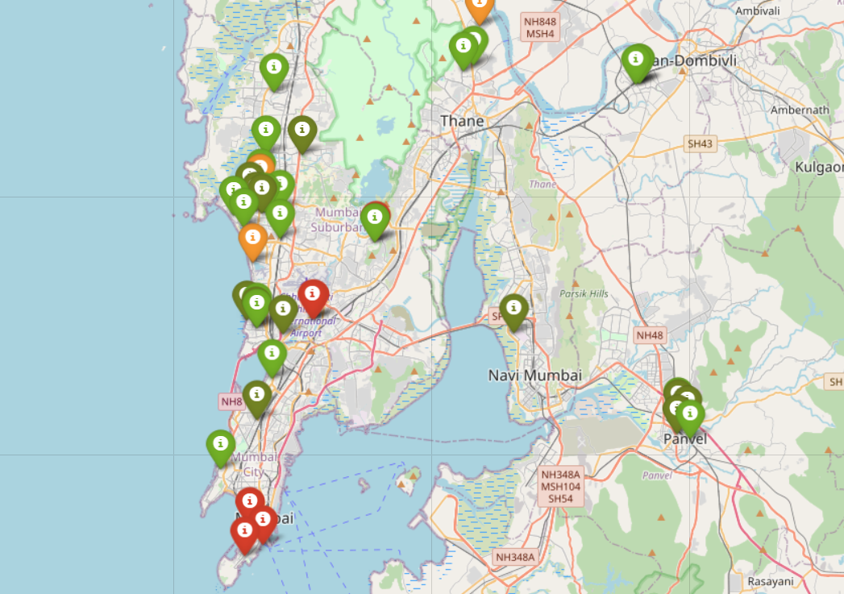
Exploratory Data Analysis
Price:
The adjoining figure includes all the venues where high-priced venues are marked by orange and red while the low-priced venues are marked with green and dark green.
From the plot, we observe that venues near Dombivali are primarily lower priced, venues near Colaba and Chhatrapathi Shivaji International Airport have steep prices. Bandra, Powai and Jogeshwari seem to have a mix of both high-priced and low-priced venues.

Slide 17
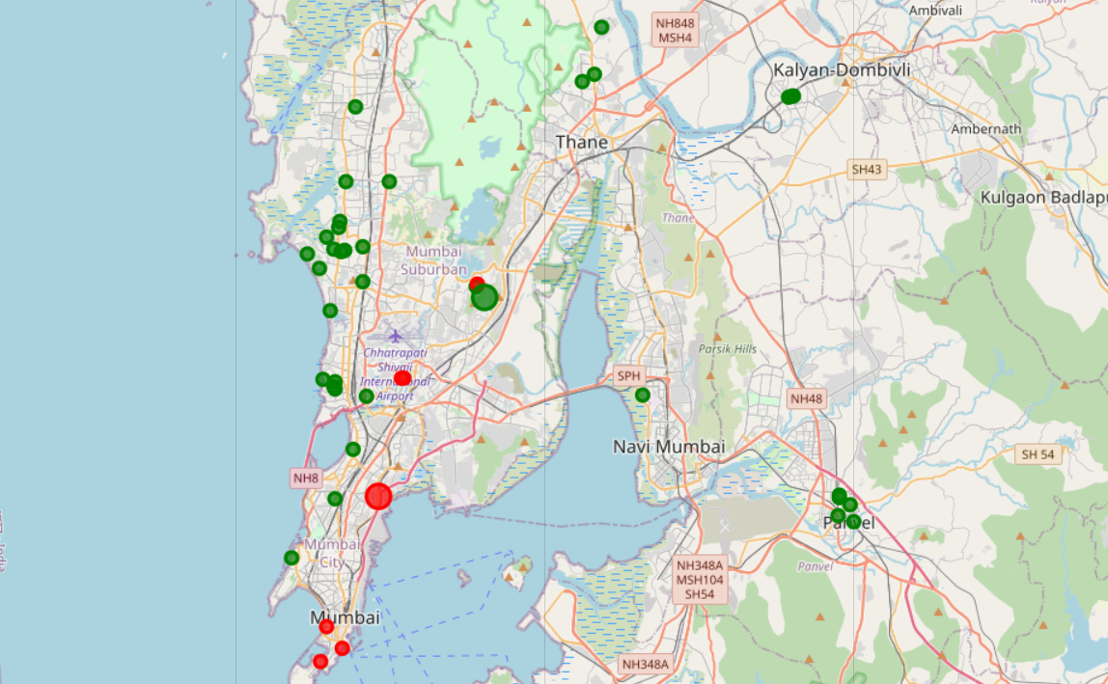
Exploratory Data Analysis
Clustering:
Finally, I clustered all the venues based on their price range, location and more to identify similar venues and the relationship amongst them. I used K-Means and decided to cluster the venues into two separate groups.
We see the two clusters:
The first cluster (green) is spread across the whole city and includes the majority venues. These venues have mean price range of 1.51 and rating spread around 3.61.
The second cluster (red) is very sparsely spread and has very limited venues. These venues have mean price range of 4.00 and rating spread around 4.10.

Slide 18
Results
After collecting data from the Foursquare and Zomato APIs, we got a list of 185 different venues. However, not all venues from the two APIs were identical. Hence, we had to inspect their latitude and longitude values as well as names to combine them and remove all the outliers.
We identified that from the total set of venues, majority of them were Cafes and Hotels. A visitor who is interested in these would surely have a good time in Mumbai.
While the complete range of ratings range from 1 to 5, the majority venues have ratings close to 4. This means that most restaurants provide good quality food which is liked by the people of the city, thus indicating the high rating. When we plot these venues on the map, we discover that there are clusters of venues around Bandra, Jogeshwari, Oshiwara and Colaba. These clusters also have very high ratings (more than 3).
When we take a look at the price values of each venue, we explore that many venues have prices which are in the range of Rs 150 to Rs 300 for one person. However, the variation in prices is very large, given the complete range starts from Rs 100 and goes until Rs 2100. On the venues based on their price range on the map, we discovered that venues located near the suburban regions such as Oshiwara, Goregaon, Bandra and Panvel are relatively priced lower than venues in Colaba, Bandra-Kurla Complex and regions near the International Airport.
Finally, through clusters we identified that there are many venues which are relatively lower priced but have an average rating of 3.61. On the other hand, there are a few venues which are high priced and have average rating of 4.10.
If you're looking for cheap places with relatively high rating, you should check Oshiwara and Jogeshwari.
If you're looking for the best places, with the highest rating but might also carry a high price tag, you should visit Colaba and Bandra-Kurla Complex.
If you're looking to explore the city and have no specific criteria to decide upon the places you want to visit, you should try Bandra-West and Powai.
A company can use this information to build up an online website/mobile application, to provide users with up to date information about various venues in the city based on the search criteria (name, rating and price).

Slide 19
CONCLUSION
The purpose of this project was to explore the places that a person travelling to Mumbai could visit.
The venues have been identified using Foursquare and Zomato API and have been plotted on the map.
The map reveals the following as the major areas a person can visit: Bandra, Oshiwara, Jogeshwari, Colaba, Bandra-Kurla Complex and Powai.
Based on the visitor's venue rating and price requirements, they can choose amongst the above-mentioned places.

